Slide 1
지도 데이터 활용

Slide 2
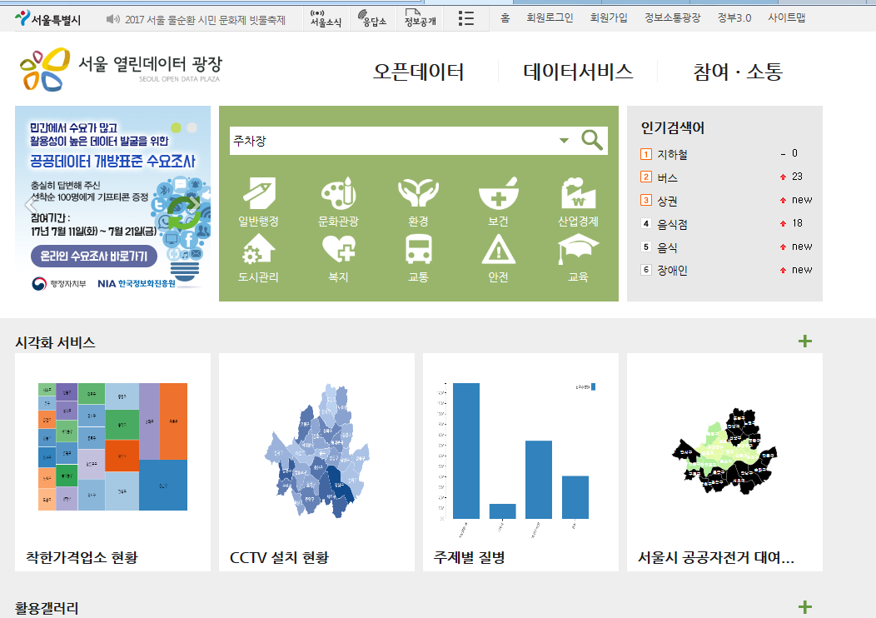
http://data.seoul.go.kr 에 접속

Slide 3
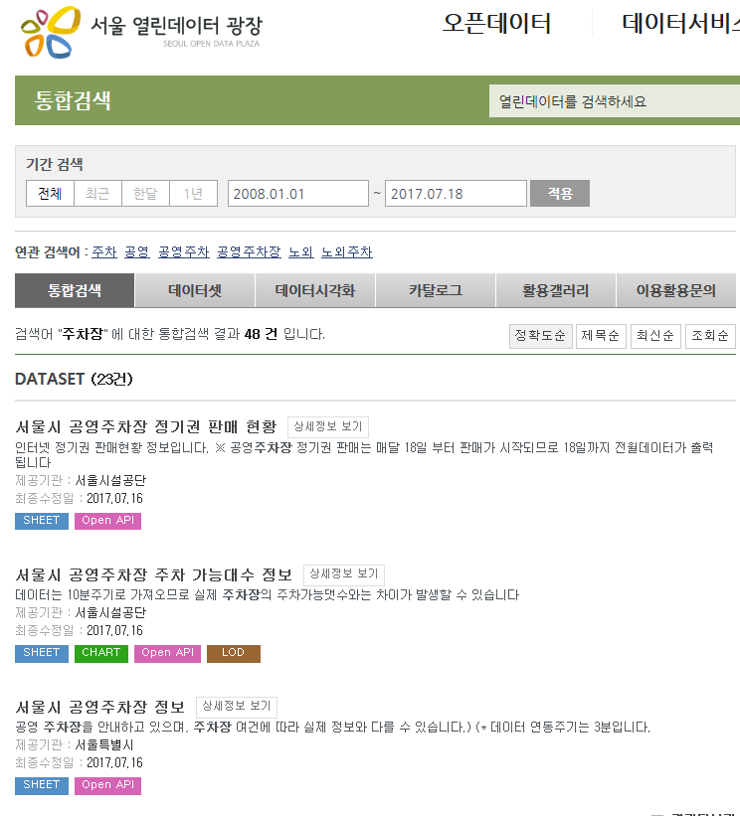

Slide 4
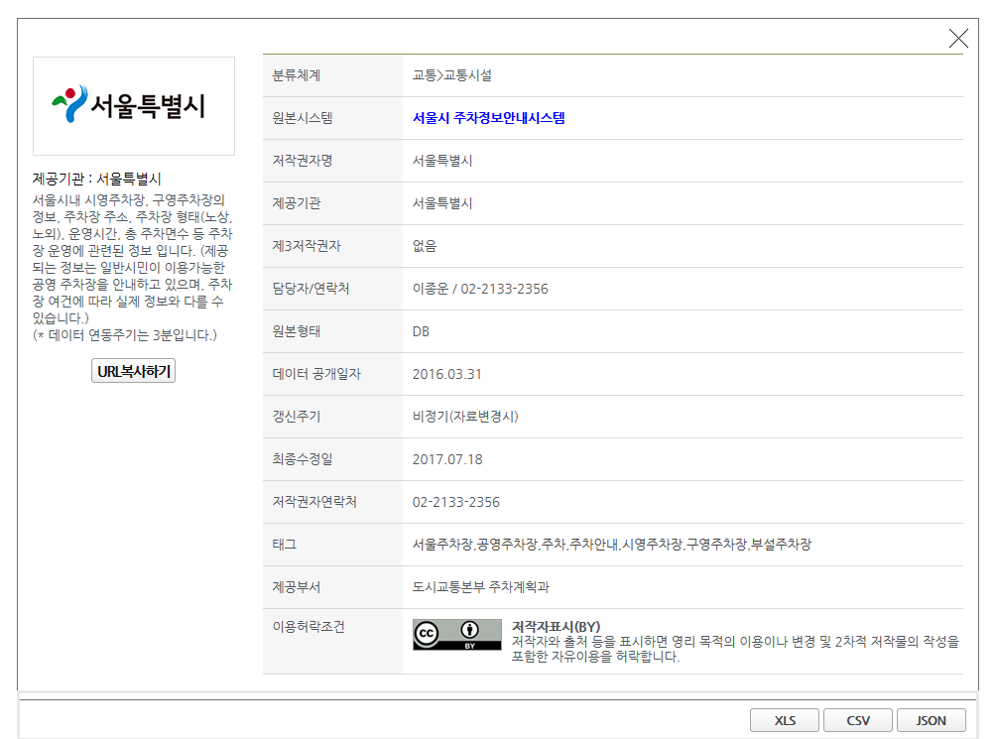

Slide 5
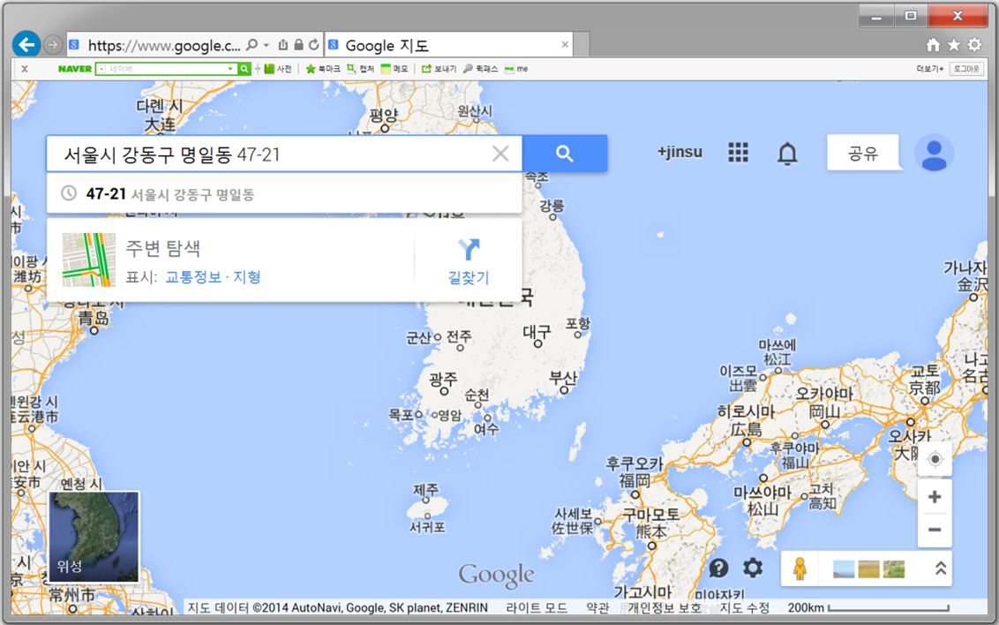
http://www.google.co.kr/maps 에 접속한 후 주소를 입력

Slide 6
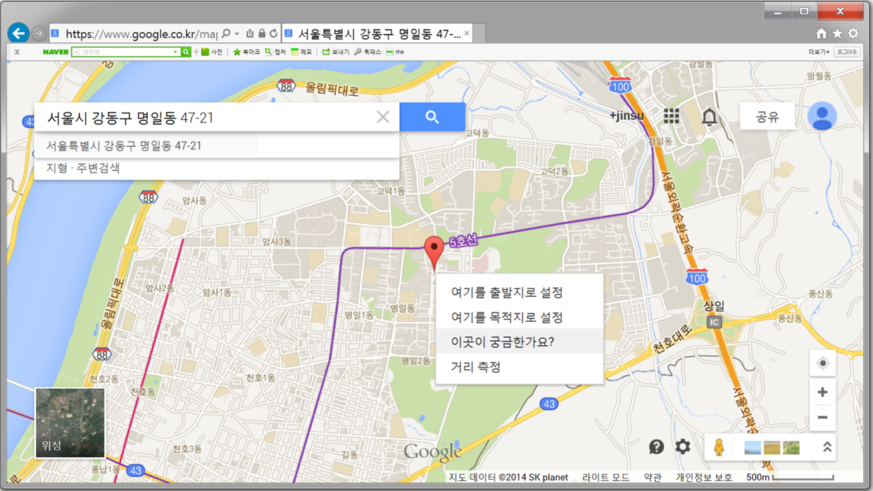

Slide 7
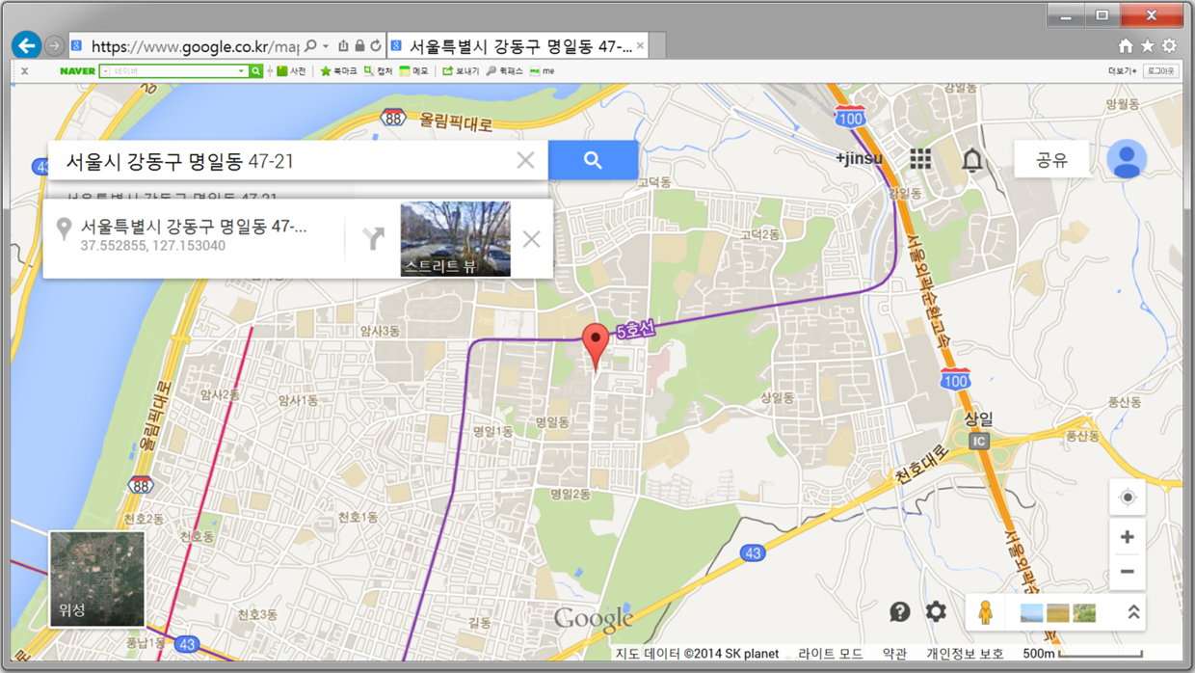

Slide 8
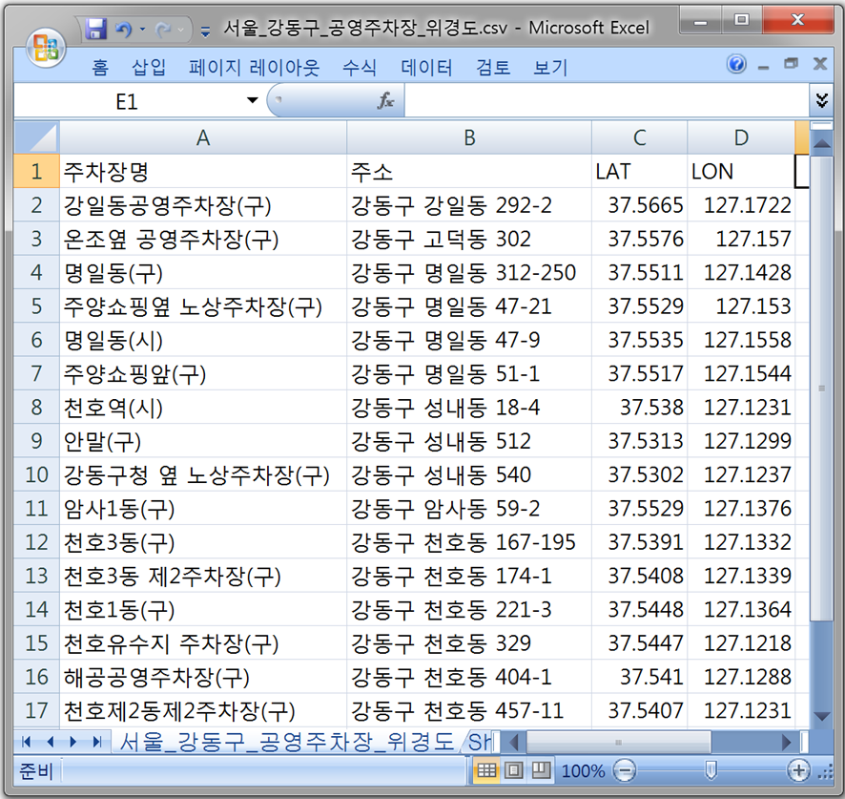

Slide 9
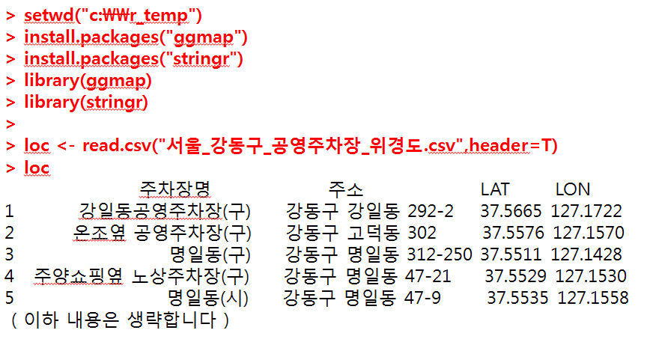

Slide 10
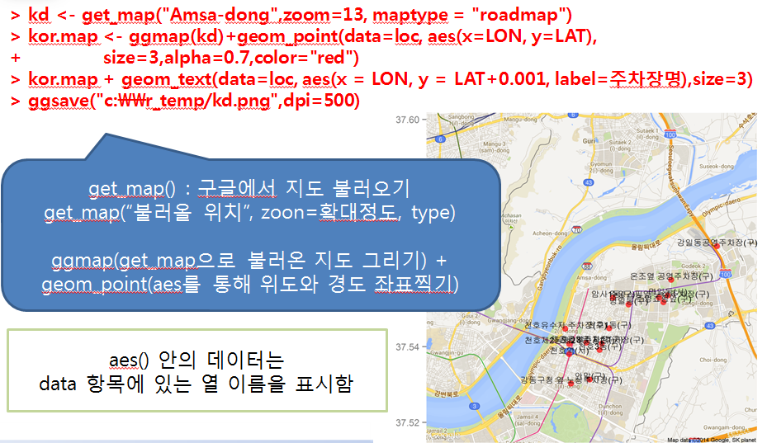
Notes:
setwd("c:\\easy_r")
install.packages("ggmap")
install.packages("stringr")
library(ggmap)
library(stringr)
loc<-read.csv("서울_강동구_공영주차장_위경도.csv",header=T)
loc
kd<-get_map("Amsa-dong",zoom=13,maptype="roadmap")
kor.map<-ggmap(kd)+geom_point(data=loc,aes(x=LON,y=LAT),size=3,alpha=0.7,color="red")
kor.map+geom_text(data=loc,aes(x=LON,y=LAT+0.001,label=주차장명),size=3)
ggsave("c:\\easy_r/kd.png",dpi=500)

Slide 11
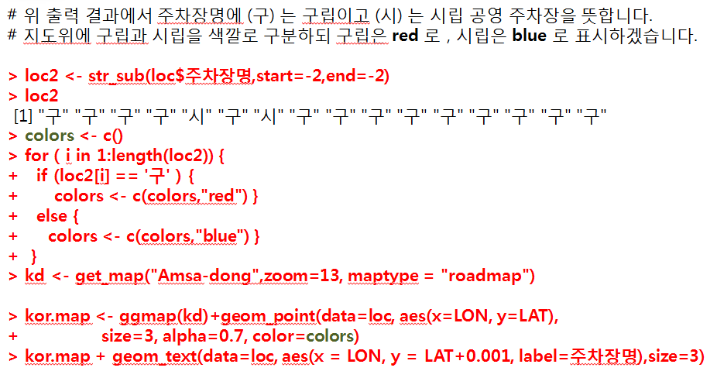
Notes:
setwd("c:\\easy_r")
install.packages("ggmap")
install.packages("stringr")
library(ggmap)
library(stringr)
loc<-read.csv("서울_강동구_공영주차장_위경도.csv",header=T)
loc
kd<-get_map("Amsa-dong",zoom=13,maptype="roadmap")
kor.map<-ggmap(kd)+geom_point(data=loc,aes(x=LON,y=LAT),size=3,alpha=0.7,color="red")
kor.map+geom_text(data=loc,aes(x=LON,y=LAT+0.001,label=주차장명),size=3)
ggsave("c:\\easy_r/kd.png",dpi=500)
loc2<-str_sub(loc$주차장명,start=-2,end=-2)
loc2
colors<-c()
for(i in 1:length(loc2)){
if (loc2[i]=='구'){
colors<-c(colors,"red")
}
else{
colors<-c(colors,"blue")
}
kd<-get_map("Amsa-dong",zoom=13,maptype = "roadmap")
kor.map<-ggmap(kd)+geom_point(data=loc,aes(x=LON,y=LAT),size=3,alpha=0.7, color=colors)
kor.map+geom_text(data=loc,aes(x=LON,y=LAT+0.001,label=주차장명),size=3)

Slide 12
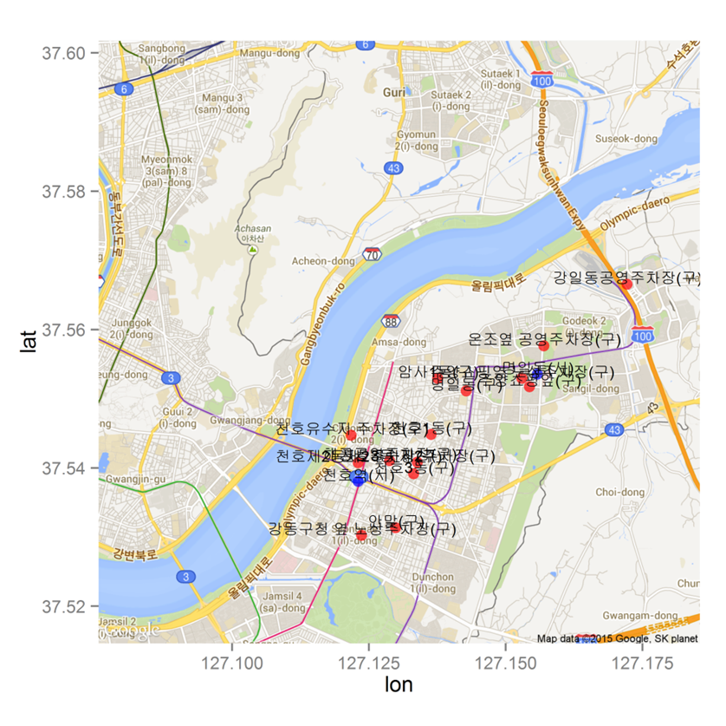
Notes:
setwd("c:\\easy_r")
install.packages("ggmap")
install.packages("stringr")
library(ggmap)
library(stringr)
loc<-read.csv("서울_강동구_공영주차장_위경도.csv",header=T)
loc
kd<-get_map("Amsa-dong",zoom=13,maptype="roadmap")
kor.map<-ggmap(kd)+geom_point(data=loc,aes(x=LON,y=LAT),size=3,alpha=0.7,color="red")
kor.map+geom_text(data=loc,aes(x=LON,y=LAT+0.001,label=주차장명),size=3)
ggsave("c:\\easy_r/kd.png",dpi=500)
loc2<-str_sub(loc$주차장명,start=-2,end=-2)
loc2
colors<-c()
for(i in 1:length(loc2)){
if (loc2[i]=='구'){
colors<-c(colors,"red")
}
else{
colors<-c(colors,"blue")
}
kd<-get_map("Amsa-dong",zoom=13,maptype = "roadmap")
kor.map<-ggmap(kd)+geom_point(data=loc,aes(x=LON,y=LAT),size=3,alpha=0.7, color=colors)
kor.map+geom_text(data=loc,aes(x=LON,y=LAT+0.001,label=주차장명),size=3)

Slide 13
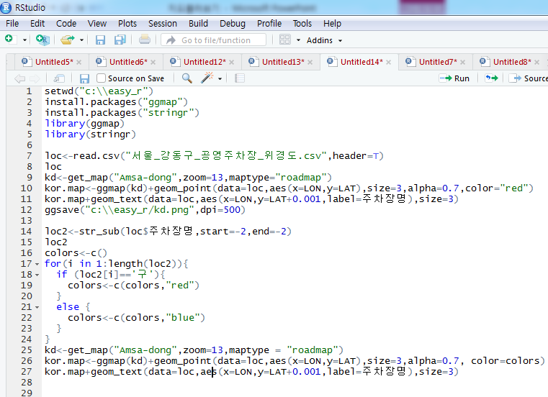
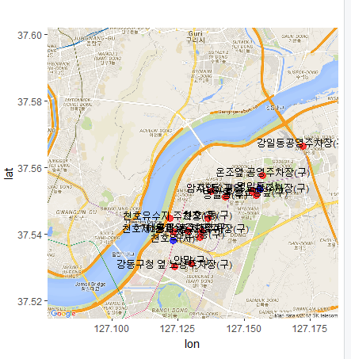
Easy_r 폴더에 kd 파일이 생김
Notes:
setwd("c:\\easy_r")
install.packages("ggmap")
install.packages("stringr")
library(ggmap)
library(stringr)
loc<-read.csv("서울_강동구_공영주차장_위경도.csv",header=T)
loc
kd<-get_map("Amsa-dong",zoom=13,maptype="roadmap")
kor.map<-ggmap(kd)+geom_point(data=loc,aes(x=LON,y=LAT),size=3,alpha=0.7,color="red")
kor.map+geom_text(data=loc,aes(x=LON,y=LAT+0.001,label=주차장명),size=3)
ggsave("c:\\easy_r/kd.png",dpi=500)
loc2<-str_sub(loc$주차장명,start=-2,end=-2)
loc2
colors<-c()
for(i in 1:length(loc2)){
if (loc2[i]=='구'){
colors<-c(colors,"red")
}
else {
colors<-c(colors,"blue")
}
}
kd<-get_map("Amsa-dong",zoom=13,maptype = "roadmap")
kor.map<-ggmap(kd)+geom_point(data=loc,aes(x=LON,y=LAT),size=3,alpha=0.7, color=colors)
kor.map+geom_text(data=loc,aes(x=LON,y=LAT+0.001,label=주차장명),size=3)

